Slide 1
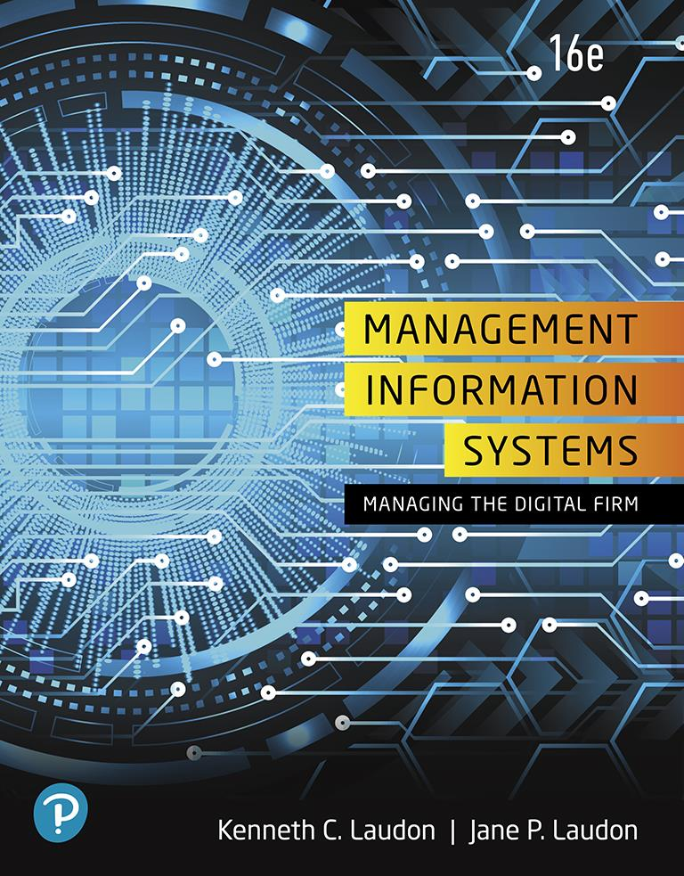
Management Information Systems: Managing the Digital Firm
Sixteenth Edition
Chapter 3
Information Systems, Organizations, and Strategy
Copyright © 2020, 2018, 2016 Pearson Education, Inc. All Rights Reserved
Notes:
If this PowerPoint presentation contains mathematical equations, you may need to check that your computer has the following installed:
1) MathType Plugin
2) Math Player (free versions available)
3) NVDA Reader (free versions available)

Slide 2
Learning Objectives
3.1 Which features of organizations do managers need to know about to build and use information systems successfully?
3.2 What is the impact of information systems on organizations?
3.3 How do Porter’s competitive forces model, the value chain model, synergies, core competencies, and network economics help companies develop competitive strategies using information systems?
3.4 What are the challenges posed by strategic information systems, and how should they be addressed?
3.5 How will MIS help my career?
Notes:
You could ask students to recall some concepts from the previous chapters that might help managers build and use information systems successfully. Answers could include what business processes the company performs, the size of the company, or the organization of the information systems function.

Slide 3
Video Cases
Case 1: G E Becomes a Digital Firm: The Emerging Industrial Internet
Case 2: National Basketball Association: Competing on Global Delivery with Akamai O S Streaming

Slide 4
Technology Helps Starbucks Find Better Ways to Compete (1 of 2)
Problem
Opportunities from new technology
Store-based model
Intense competition
Solutions
Determine business strategy
Design new in-store products and services
Redesign business processes
Partner with other vendors
Mine customer data

Slide 5
Technology Helps Starbucks Find Better Ways to Compete (2 of 2)
Wi-Fi wireless network
Smartphones
Mobile Order and Pay app
Demonstrates I T’s role in helping organizations strengthen their competitive strategies by using new technologies

Slide 6
The Relationship Between Organizations and Information Technology
Information technology and organizations influence each other
Relationship influenced by organization’s
Structure
Business processes
Politics
Culture
Environment
Management decisions
Notes:
This concept was briefly discussed in Chapter 1. Figures 1-2 and 1-3 as well as the figure on the next slide, 3-1, display this interdependent relationship graphically.

Slide 7
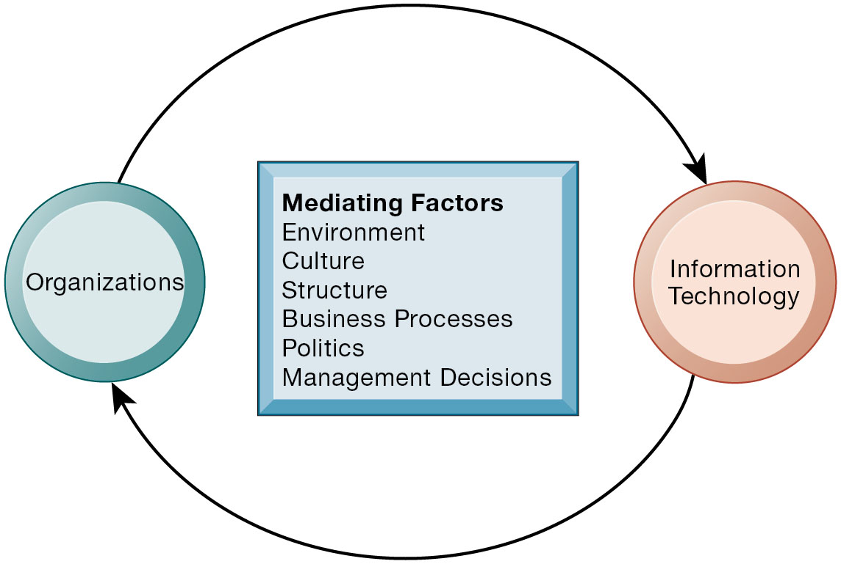
Figure 3.1 The Two-Way Relationship Between Organizations and Information Technology
Notes:
Figure 3.1, Page 82.
This complex two-way relationship is mediated by many factors, not the least of which are the decisions made—or not made—by managers. Other factors mediating the relationship include the organizational culture, structure, politics, business processes, and environment.
Ask students to explain how each factor might affect the relationship between organizations and information technology. Emphasize to students that the relationship between these two and its effects on the future of a business are difficult to predict. For example, very few people could have predicted the prominence of e-mail, texting, or social media in business communication 15 years ago.

Slide 8
What Is an Organization?
Technical definition
Formal social structure that processes resources from environment to produce outputs
A formal legal entity with internal rules and procedures, as well as a social structure
Behavioral definition
A collection of rights, privileges, obligations, and responsibilities that is delicately balanced over a period of time through conflict and conflict resolution
Notes:
Which of the two definitions do students find more accurate and why? It is important to consider both definitions rather than exclusively use one at the expense of the other. The two definitions are complementary.

Slide 9
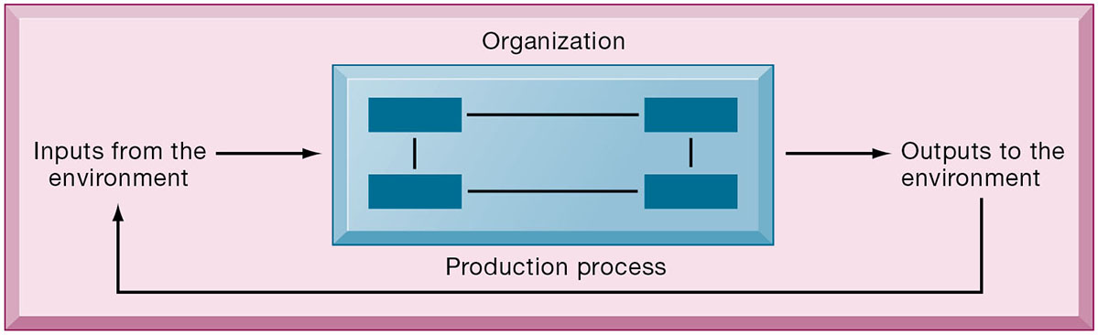
Figure 3.2 The Technical Microeconomic Definition of the Organization
Notes:
Figure 3.2, Page 82.
In the microeconomic definition of organizations, capital and labor (the primary production factors provided by the environment) are transformed by the firm through the production process into products and services (outputs to the environment). The products and services are consumed by the environment, which supplies additional capital and labor as inputs in the feedback loop.
Ask students what are the inputs from the environment? What do organizations output (goods and services). In this view, the organization or business firm is rather easily changed, and malleable. The organization is a collection of parts, like a machine, that can be rearranged as needed. There are no humans in this model, or if there are, they are assumed to be relatively simple.

Slide 10
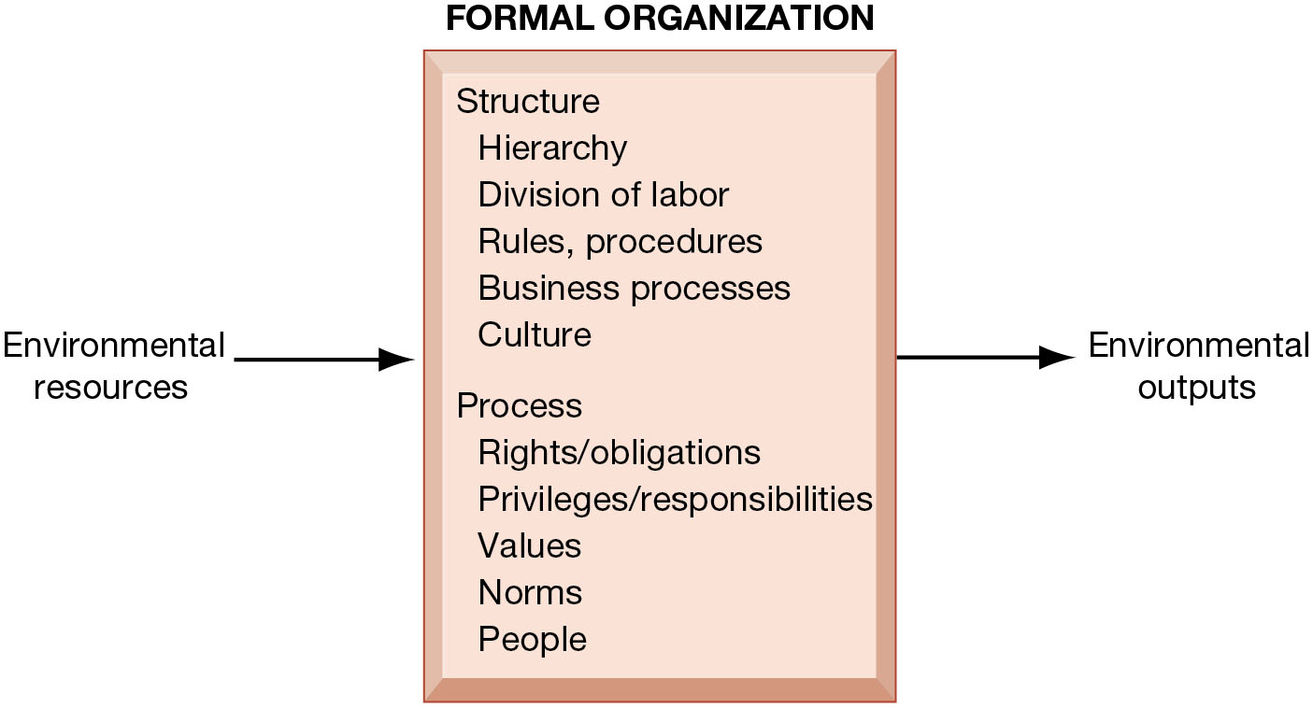
Figure 3.3 The Behavioral View of Organizations
Notes:
Figure 3.3, Page 83.
The behavioral view of organizations emphasizes group relationships, values, and structures.
In this view, the business firm is a little more difficult to change rapidly or on-command because it is a very complex machine populated with human beings. Firms operate with an existing hierarchy, job definitions, business rules, legal contracts, procedures, and processes. Efficient organizations become very good at these elements of business. Changing these elements takes more time.
Full description: Formal organizations consist of structure and process. Structure involves hierarchy, division of labor, rules, procedures, business procedures, and cultures. Process involves rights and obligations, privileges, responsibilities, values, norms, and people. Moving into the organization are environmental resources and moving out from the organization are environmental outputs.

Slide 11
Features of Organizations
Use of hierarchical structure
Accountability, authority in system of impartial decision making
Adherence to principle of efficiency
Routines and business processes
Organizational politics, culture, environments, and structures
Notes:
You could ask students to envision what would happen to an organization that did not use a hierarchical structure (would anything get done?), did not adhere to the principle of efficiency (would they provide any good or service worth using at an affordable price?), and so on.

Slide 12
Routines and Business Processes
Routines (standard operating procedures)
Precise rules, procedures, and practices developed to cope with virtually all expected situations
Business processes: Collections of routines
Business firm: Collection of business processes
Notes:
You could ask students to describe examples of situations where a business they have interacted with has had a well-understood set of routines. One such example is at the doctor’s office, where the receptionist, nurses, and doctors all have a defined set of routines. Ask students to think about and describe routines they performed on their jobs.

Slide 13
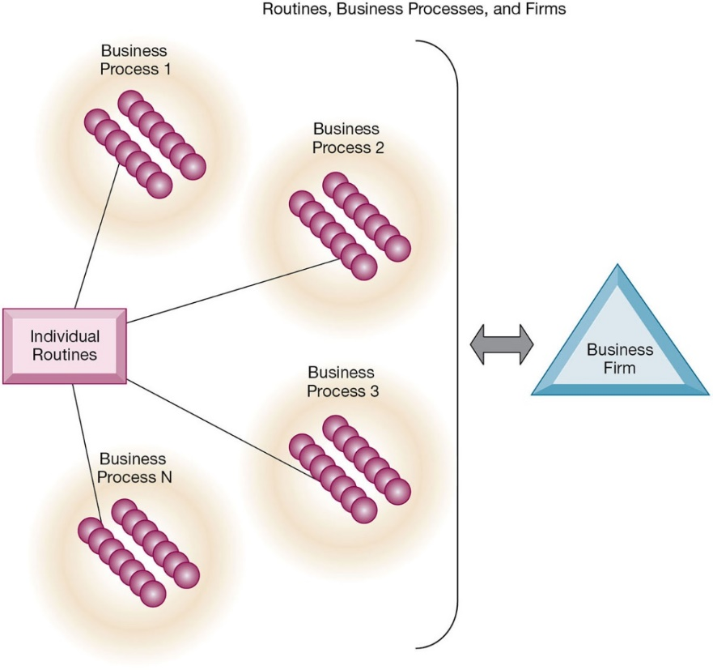
Figure 3.4 Routines, Business Processes, and Firms
Notes:
Figure 3.4, Page 85.
All organizations are composed of individual routines and behaviors, a collection of which make up a business process. A collection of business processes make up the business firm. New information system applications require that individual routines and business processes change to achieve high levels of organizational performance.
Explain to students that the blue spheres are individual routines, which together constitute a business process. A firm can be seen as a collection of these processes.

Slide 14
Organizational Politics
Divergent viewpoints lead to political struggle, competition, and conflict
Political resistance greatly hampers organizational change
Notes:
You could ask students to describe examples where organizational politics might hamper a firm’s ability to succeed, or examples where effectively managed organizational politics helps a company to undergo a smoother transition or make more intelligent decisions. Ask students to describe their personal experiences with “organizational politics.”

Slide 15
Organizational Culture
Encompasses set of assumptions that define goal and product
What products the organization should produce
How and where it should be produced
For whom the products should be produced
May be powerful unifying force as well as restraint on change
Notes:
Culture may seem like a pretty abstract idea to many students. On the other hand, students with work experiences will easily be able to describe the cultures of firms where they have worked. Ask students to describe organizational cultures they have experienced while on the job, or other areas of their lives. What kind of organizational culture do students prefer and why? Ask students to describe different kinds of cultures and what types of firms are more likely to have them.

Slide 16
Organizational Environments
Organizations and environments have a reciprocal relationship
Organizations are open to, and dependent on, the social and physical environment
Organizations can influence their environments
Environments generally change faster than organizations
Information systems can be instrument of environmental scanning, act as a lens
Notes:
Explain that environmental scanning involves searching for and determining external changes that may require an organizational response. The current economic climate represents an example of external change that requires sweeping organizational responses to ensure survival.

Slide 17
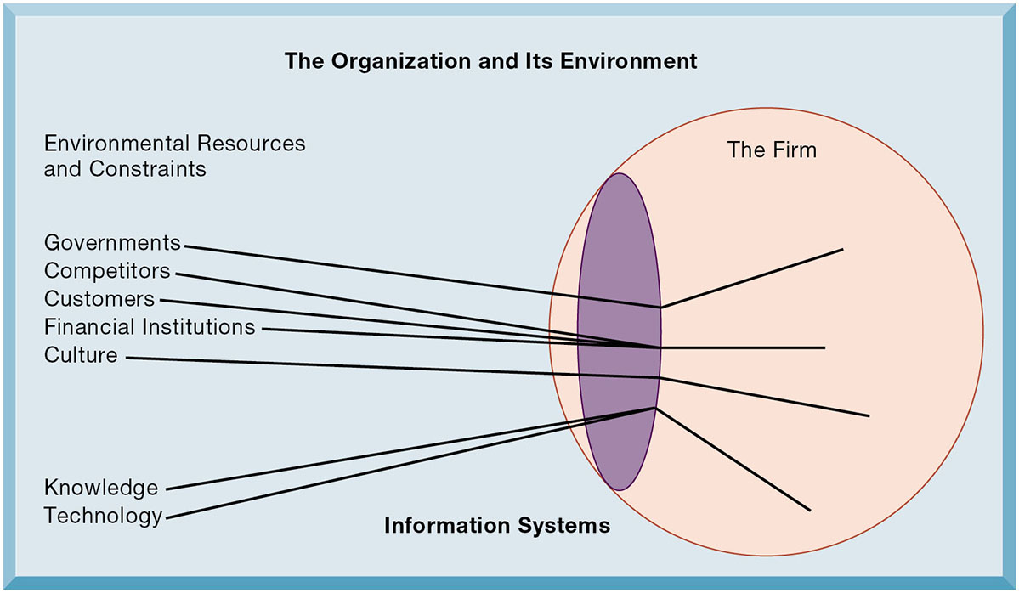
Figure 3.5 Environments and Organizations Have a Reciprocal Relationship
Notes:
Figure 3.5, Page 86.
Environments shape what organizations can do, but organizations can influence their environments and decide to change environments altogether. Information technology plays a critical role in helping organizations perceive environmental change and in helping organizations act on their environment.
This graphic further establishes information systems as the “lens” of the firm, observing external factors and filtering information back in to the firm. To some extent, organizations “see” only what their systems will let them see. If systems are poorly built, they may blind managers to difficulties and problems.

Slide 18
Disruptive Technologies
Substitute products that perform as well as or better than existing product
Technology that brings sweeping change to businesses, industries, markets
Examples: personal computers, smartphones, Big Data, artificial intelligence, the Internet
First movers and fast followers
First movers—inventors of disruptive technologies
Fast followers—firms with the size and resources to capitalize on that technology
Notes:
Ensure that students understand that the PageRank algorithm is the underlying technology behind Google search. Ask students if they can give examples of any first movers that invented a disruptive technology, yet failed to last (examples might include the Altair personal computer, the Netscape Navigator Internet browser, etc.).

Slide 19
Organizational Structure
Five basic kinds of organizational structure (Mintzberg)
Entrepreneurial
Machine bureaucracy
Divisionalized bureaucracy
Professional bureaucracy
Adhocracy
Information system often reflects organizational structure
Notes:
Do students agree with the classification of these types of organizational structure? Can they come up with examples for each type of organization?

Slide 20
Other Organizational Features
Goals
Coercive, utilitarian, normative, and so on
Constituencies
Leadership styles
Types of tasks
Different environments
Notes:
Ask students to give some examples of each organizational feature listed above. For example, different organizations (prisons, businesses, colleges) have different types of goals (coercive, utilitarian, normative, respectively).

Slide 21
Economic Impacts
I T changes relative costs of capital and the costs of information
Information systems technology is a factor of production, like capital and labor
I T affects the cost and quality of information and changes economics of information
Information technology helps firms contract in size because it can reduce transaction costs (the cost of participating in markets)
Outsourcing
Notes:
IT figures to replace the function of more middle managers as time passes, as well as reduce the need for other forms of capital (buildings, machinery). Ensure that students understand what is meant by “economics of information” and why outsourcing is a possibility due to IT.

Slide 22
Transaction Cost Theory
Firms seek to economize on transaction costs (the costs of participating in markets)
Vertical integration, hiring more employees, buying suppliers and distributors
I T lowers market transaction costs, making it worthwhile for firms to transact with other firms rather than grow the number of employees
Notes:
Explain that using the market can be expensive. If you depend on the market, rather than hiring employees, you will need to search for talent, research the quality of providers and workers, write contracts for work to be performed, monitor the work, and so forth. When participation in markets is expensive, firms would rather hire employees to accomplish their work. But the Internet makes it less expensive to use the marketplace. With the Internet, firms find it more cost effective to use the marketplace and contract for work in a market, rather than hire employees. Ask your students why the Internet can make participating in markets less expensive than before.

Slide 23
Agency Theory
Firm is nexus of contracts among self-interested parties requiring supervision
Firms experience agency costs (the cost of managing and supervising) which rise as firm grows
I T can reduce agency costs, making it possible for firms to grow without adding to the costs of supervising, and without adding employees
Notes:
By characterizing employees as independent agents requiring constant supervision, agency theory underscores a key reason that costs increase as firms grow in size and scope—the need to expend more effort managing their employees.

Slide 24
Organizational and Behavioral Impacts
I T flattens organizations
Decision making is pushed to lower levels
Fewer managers are needed (I T enables faster decision making and increases span of control)
Postindustrial organizations
Organizations flatten because in postindustrial societies, authority increasingly relies on knowledge and competence rather than formal positions
Notes:
Ask students to explain what is meant by authority relying on knowledge and competence rather than formal positions. Why might this “flatten” the organization? The idea here is that with sufficient IT, competent workers will be able to accomplish more on their own than they would under a more hierarchical arrangement.

Slide 25
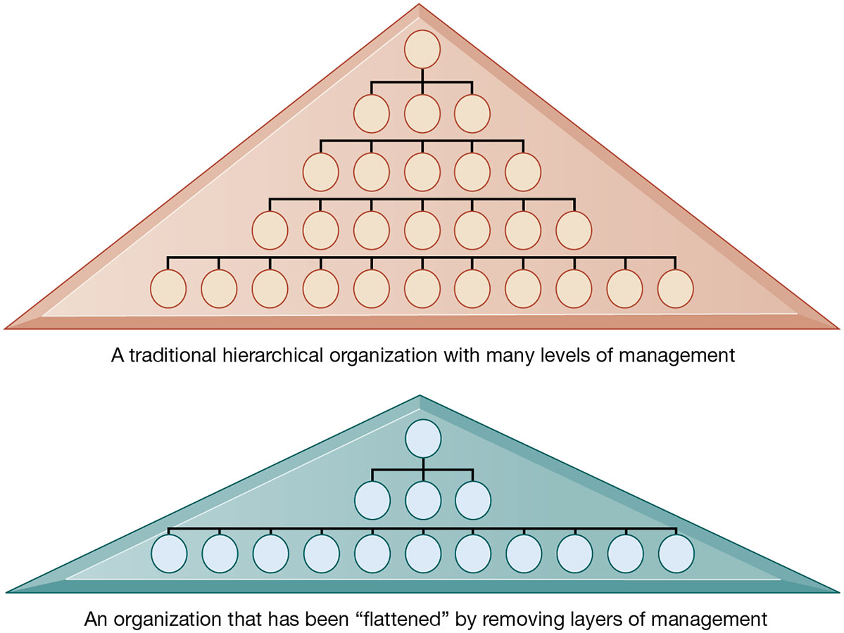
Figure 3.6 Flattening Organizations
Notes:
Figure 3.6, Page 91
Information systems can reduce the number of levels in an organization by providing managers with information to supervise larger numbers of workers and by giving lower-level employees more decision-making authority.
Ask students to explain some of the benefits of the flattened organization as opposed to the more complicated hierarchy in the top of the diagram. Information travels through fewer levels to its intended recipients; there are fewer managers, so agency costs are smaller, and firms can act faster (less decision delay).

Slide 26
Understanding Organizational Resistance to Change
Information systems become bound up in organizational politics because they influence access to a key resource—information
Information systems potentially change an organization’s structure, culture, politics, and work
Four factors
Nature of the innovation
Structure of organization
Culture of organization
Tasks affected by innovation
Notes:
Explain what is meant by changes in culture and politics of the firm. For example, workers may resist changes that disrupt their routines. Also explain to students that as important as technical understanding of information systems may be for potential managers, it is equally important to understand the people and organizational structures and customs affected by information systems.

Slide 27
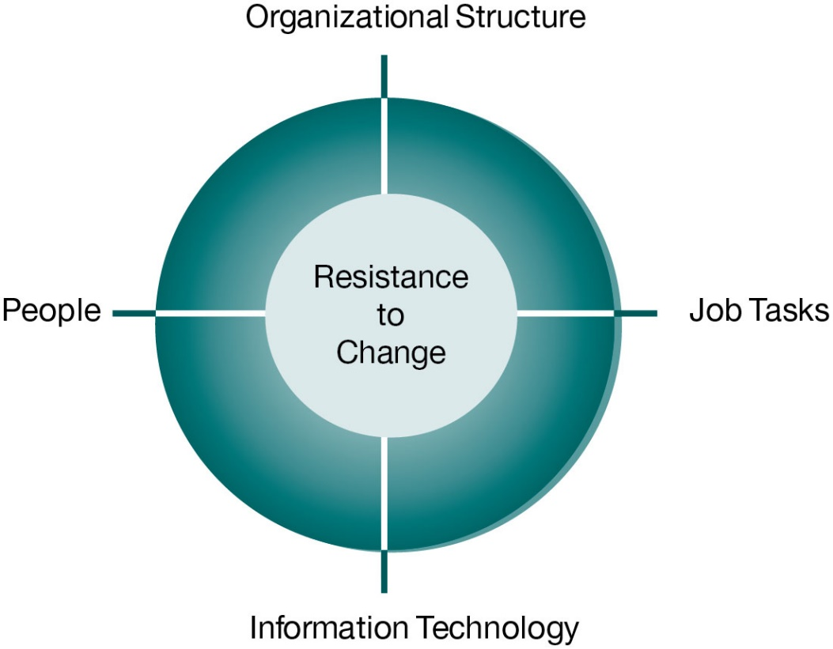
Figure 3.7 Organizational Resistance to Information System Innovations
Notes:
Figure 3.7, Page 92.
Implementing information systems has consequences for task arrangements, structures, and people. According to this model, to implement change, all four components must be changed simultaneously.
The circle shape in the figure represents the mutual relationship among the concepts shown.

Slide 28
The Internet and Organizations
The Internet increases the accessibility, storage, and distribution of information and knowledge for organizations
The Internet can greatly lower transaction and agency costs
Example: Large firm delivers internal manuals to employees via a corporate website, saving millions of dollars in distribution costs
Notes:
The Internet should also have a flattening effect on many organizations. Can students describe any businesses that have become more efficient and flat thanks to successful incorporation of the Internet in their operations? Some older students may remember the “bad old days” when seven or more levels of management needed to decide even simple issues in a typical firm. Many Fortune 1000 firms are still like this.

Slide 29
Implications for the Design and Understanding of Information Systems
Organizational factors in planning a new system:
Environment
Structure
Hierarchy, specialization, routines, business processes
Culture and politics
Type of organization and style of leadership
Main interest groups affected by system; attitudes of end users
Tasks, decisions, and business processes the system will assist
Notes:
Ask students to consider the results of an information system implemented without properly considering each of the above factors. For example, an information system designed without an understanding of the company’s culture and politics is likely to be unpopular, perhaps forcing employees to drastically deviate from their previous routines.

Slide 30
Porter’s Competitive Forces Model (1 of 3)
Why do some firms become leaders in their industry?
Michael Porter’s competitive forces model
Provides general view of firm, its competitors, and environment
Five competitive forces shape fate of firm:
Traditional competitors
New market entrants
Substitute products and services
Customers
Suppliers
Notes:
Porter’s competitive forces model is intended to explain why some firms do better than others. Do students believe that this model captures this idea effectively? Which factor is most important to a firm’s success? You can make a list of five well-known firms on the blackboard or screen and ask students, for each firm, which do they think are the most important competitive forces.

Slide 31
Porter’s Competitive Forces Model (2 of 3)
Traditional competitors
All firms share market space with competitors who are continuously devising new products, services, efficiencies, and switching costs
New market entrants
Some industries have high barriers to entry, for example, computer chip business
New companies have new equipment, younger workers, but little brand recognition
Notes:
Ask students to name different industries and describe the benefits and drawbacks of being a new market entrant in each industry.

Slide 32
Porter’s Competitive Forces Model (3 of 3)
Substitute products and services
Substitutes customers might use if your prices become too high, for example, i Tunes substitutes for C D s
Customers
Can customers easily switch to competitor's products? Can they force businesses to compete on price alone in transparent marketplace?
Suppliers
Market power of suppliers when firm cannot raise prices as fast as suppliers
Notes:
Ask students to name different businesses and describe whether or not customers have great control over the business or vice versa, or whether substitute products are a large or insignificant threat to the success of the business.

Slide 33
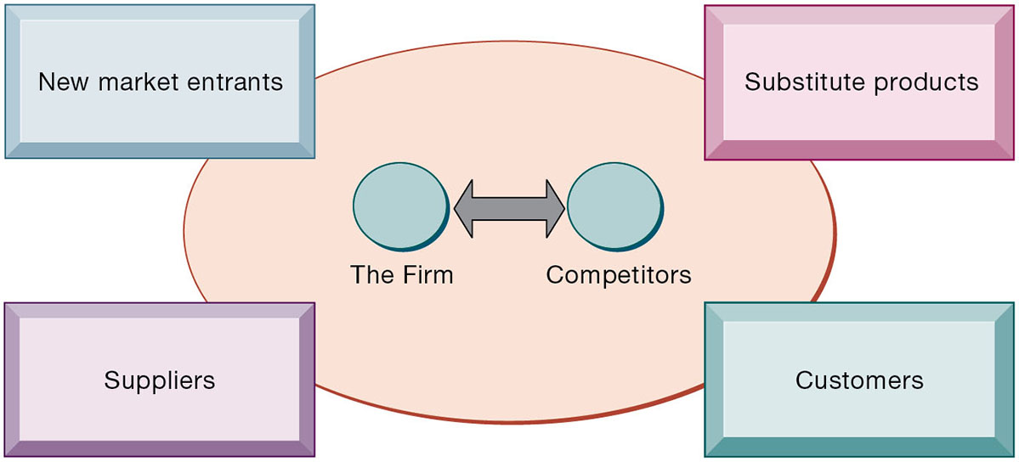
Figure 3.8 Porter’s Competitive Forces Model
Notes:
Figure 3.8, Page 94.
In Porter’s competitive forces model, the strategic position of the firm and its strategies are determined not only by competition with its traditional direct competitors but also by four other forces in the industry’s environment: new market entrants, substitute products, customers, and suppliers.
Notice that in the graphic, competitors are represented differently than the other four competitive forces influencing a firm. Why do students think this is the case? One answer might be that competitors are firms in the same industry and are under similar pressures as other firms in the industry.

Slide 34
Information System Strategies for Dealing with Competitive Forces (1 of 3)
Four generic strategies for dealing with competitive forces, enabled by using I T:
Low-cost leadership
Product differentiation
Focus on market niche
Strengthen customer and supplier intimacy
Notes:
Here you can make a list of five well-known firms and then analyze with students the major thrust of their strategy. Walmart is a good example to start with because of its emphasis on low-cost leadership.

Slide 35
Information System Strategies for Dealing with Competitive Forces (2 of 3)
Low-cost leadership
Produce products and services at a lower price than competitors
Example: Walmart’s efficient customer response system
Product differentiation
Enable new products or services, greatly change customer convenience and experience
Example: Google, Nike, Apple
Mass customization
Notes:
Do students believe it is possible both to design information systems that focus both on low-cost leadership and product differentiation? Some may say it is with sufficient planning and innovation; perhaps a new product is even cheaper to produce than older ones. Some may say that the investment in innovation required for product differentiation precludes that firm from maintaining low-cost leadership.

Slide 36
Information System Strategies for Dealing with Competitive Forces (3 of 3)
Focus on market niche
Use information systems to enable a focused strategy on a single market niche; specialize
Example: Hilton Hotels’ O n Q system
Strengthen customer and supplier intimacy
Use information systems to develop strong ties and loyalty with customers and suppliers
Increase switching costs
Examples: Chrysler, Amazon, Starbucks
Notes:
You could ask students to provide other examples from their own experience of companies that exemplify strong focus on market niche as well as excellent customer and supplier intimacy.

Slide 37
Interactive Session: Organizations: Digital Technology Helps Crayola Brighten Its Brand
Class Discussion
Analyze Crayola’s problem. What management, organization, and technology factors contributed to the problem?
What competitive strategies is Crayola pursuing? How does digital technology support those strategies?
What people issues did Crayola have to address in designing its new technology-based products?
How has digital technology changed Crayola’s business model and the way it runs its business?

Slide 38
The Internet’s Impact on Competitive Advantage
Transformation or threat to some industries
Examples: travel agency, printed encyclopedia, media
Competitive forces still at work, but rivalry more intense
Universal standards allow new rivals, entrants to market
New opportunities for building brands and loyal customer bases
Notes:
Do students believe it is easier or harder to gain a competitive advantage via the Internet as opposed to more traditional means? Table 3-5 describes the impact of the Internet on various competitive forces.

Slide 39
Smart Products and the Internet of Things
Internet of Things (I o T)
Growing use of Internet-connected sensors in products
Smart products
Fitness equipment, health trackers
Expand product differentiation opportunities
Increasing rivalry between competitors
Raise switching costs
Inhibit new entrants
May decrease power of suppliers
Notes:
Ask students about how they are using IoT devices from fitness trackers to smart home products, including smart assistances like Alexa and Siri. Or, smart assistances in their cars. Do they find these products “smart”?

Slide 40
Interactive Session: Technology: Smart Products—Coming Your Way
Class discussion
Describe the role of information technology in the products described in this case. How is it adding value to these products? How is it transforming these products?
How are these smart products changing operations and decision making for these organizations? How are they changing the behavior of their users?
Are there any ethical issues raised by these smart products, such as their impact on consumer privacy? Explain your answer.

Slide 41
The Business Value Chain Model
Firm as series of activities that add value to products or services
Highlights activities where competitive strategies can best be applied
Primary activities vs. support activities
At each stage, determine how information systems can improve operational efficiency and improve customer and supplier intimacy
Utilize benchmarking, industry best practices
Notes:
How does the value chain model differ from the Porter model? (It offers more specific detail about what exactly to do to achieve competitive advantages.) How do primary activities differ from support activities?

Slide 42
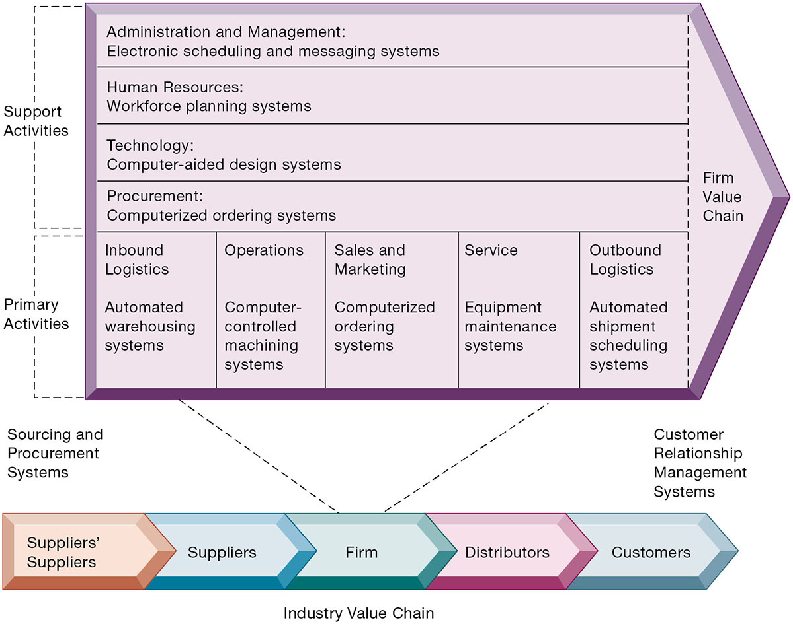
Figure 3.9 The Value Chain Model
Notes:
Figure 3.9, Page 104.
This figure provides examples of systems for both primary and support activities of a firm and of its value partners that can add a margin of value to a firm’s products or services.
Emphasize the relationship between the primary and support activities of this firm and explain how information systems are critical to the success of each activity.
Full description: The industry value chain consists of suppliers’ suppliers, suppliers, firm, distributors, and customers. At the supplier end of the chain are sourcing and procurement systems, and at the customer end are customer relationship management systems.
The firm value chain includes primary activities including the following. Inbound Logistics, including Automated warehousing systems. Operations, including Computer controlled machining systems. Sales and Marketing, including Computerized ordering systems. Service, including Equipment maintenance systems. Outbound Logistics, including Automated shipment scheduling systems. Support activities include the following. Administration and Management, including Electronic scheduling and messaging systems. Human Resources, including Workforce planning systems. Technology, including Computer aided design systems. Procurement, including Computerized ordering systems.

Slide 43
Extending the Value Chain: The Value Web
Firm’s value chain is linked to value chains of suppliers, distributors, customers
Industry value chain
Value web
Collection of independent firms using highly synchronized I T to coordinate value chains to produce product or service collectively
More customer driven, less linear operation than traditional value chain
Notes:
Explain that a value web extends beyond the boundaries of an individual firm and represents the coordination of value chains across multiple independent firms. A value web is flexible and adapts to changes in supply and demand and changing market conditions.

Slide 44
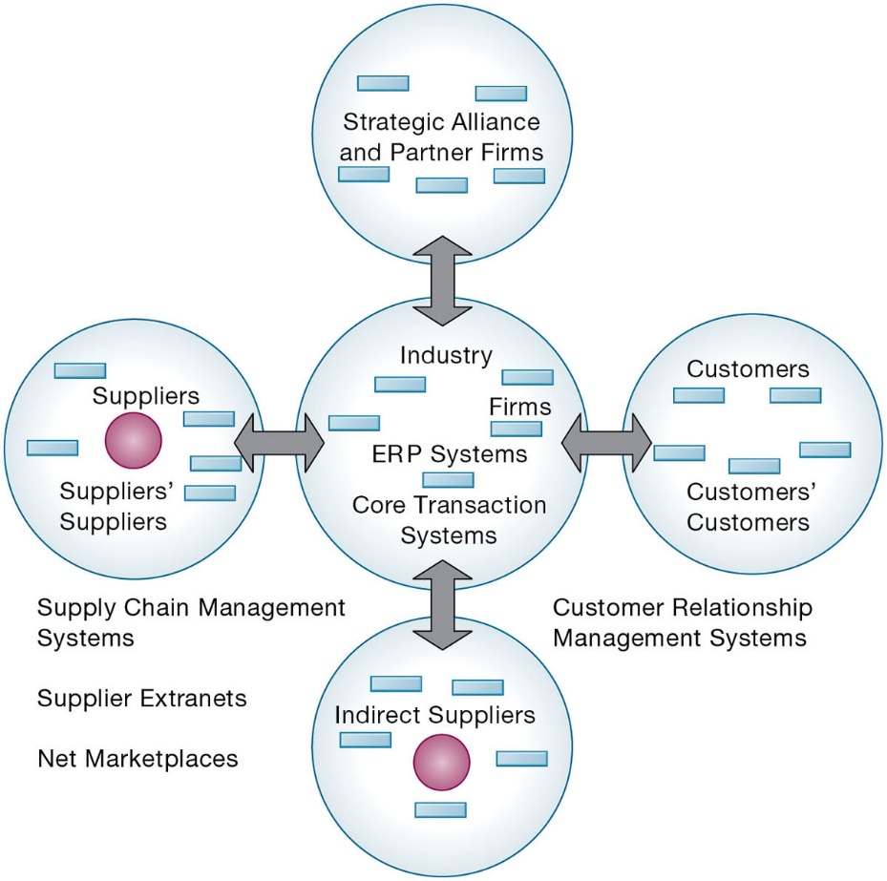
Figure 3.10 The Value Web
Notes:
Figure 3.10, Page 106.
The value web is a networked system that can synchronize the value chains of business partners within an industry to respond rapidly to changes in supply and demand.
Ask students why a model like the one displayed in the figure might be more likely to adapt quickly to changes in supply and demand. Also emphasize the networking among the different segments of the value web.
Full description: A diagram depicts a value web within an industry. At the center of the diagram is a circle that contains Industry Firms, E R P Systems, and Core Transaction Systems. Connected by bidirectional arrows to this center circle are four other circles, labeled as follows. Customers and customers’ customers, supported by customer relationship management systems. Indirect suppliers. Suppliers and suppliers’ suppliers. Strategic alliance and partner firms. Between the suppliers and indirect suppliers are supplier chain management systems, supplier extranets, and net marketplaces.

Slide 45
Synergies
When output of some units are used as inputs to others, or organizations pool markets and expertise
Example: merger of Bank of N Y and J P Morgan Chase
Purchase of YouTube by Google
Notes:
Explain that information technology’s role in promoting synergy is often tying together operations of disparate business units so that they can act as a whole. Why might this lead to reduced costs and increased efficiency?

Slide 46
Core Competencies
Activity for which firm is world-class leader
Relies on knowledge, experience, and sharing this across business units
Example: Procter & Gamble’s intranet and directory of subject matter experts
Notes:
Can students name any other notable examples of core competencies among firms? (Google: search, Microsoft: office productivity software; Intel processors, and so on)

Slide 47
Network-Based Strategies
Take advantage of firm’s abilities to network with one another
Include use of:
Network economics
Virtual company model
Business ecosystems
Notes:
Examples of firms that use this type of strategy to achieve an advantage are eBay and iVillage. Many other companies are following suit in using a network-based strategy—can students name any? eBay, iVillage, and social networking firms such as Facebook, are based on networks of millions of users. These companies have used the web and Internet communication tools to build communities. The more people who join these communities, the more benefit members receive.

Slide 48
Network Economics
Marginal cost of adding new participant almost zero, with much greater marginal gain
Value of community grows with size
Value of software grows as installed customer base grows
Compare to traditional economics and law of diminishing returns
Notes:
Explain the difference between these two schools of economics. What aspect of network economics allows value to continue to increase with the size of the community?

Slide 49
Virtual Company Model
Virtual company
Uses networks to ally with other companies
Creates and distributes products without being limited by traditional organizational boundaries or physical locations
Example: Li & Fung
Manages production, shipment of garments for major fashion companies
Outsources all work to thousands of suppliers
Notes:
Explain to students that companies like this are “virtual” because they do not actually own any factories, machines, or other similar infrastructure. Instead, they offer a series of services, aided by information systems and uninhibited by geographical boundaries.

Slide 50
Business Ecosystems and Platforms
Industry sets of firms providing related services and products
Platforms
Microsoft, Facebook
Keystone firms
Niche firms
Individual firms can consider how I T will help them become profitable niche players in larger ecosystems
Notes:
Can students see the similarities between business ecosystems and value webs? Can they appreciate the key difference (that business ecosystems extend across industries as opposed to just firms within the same industry)?

Slide 51
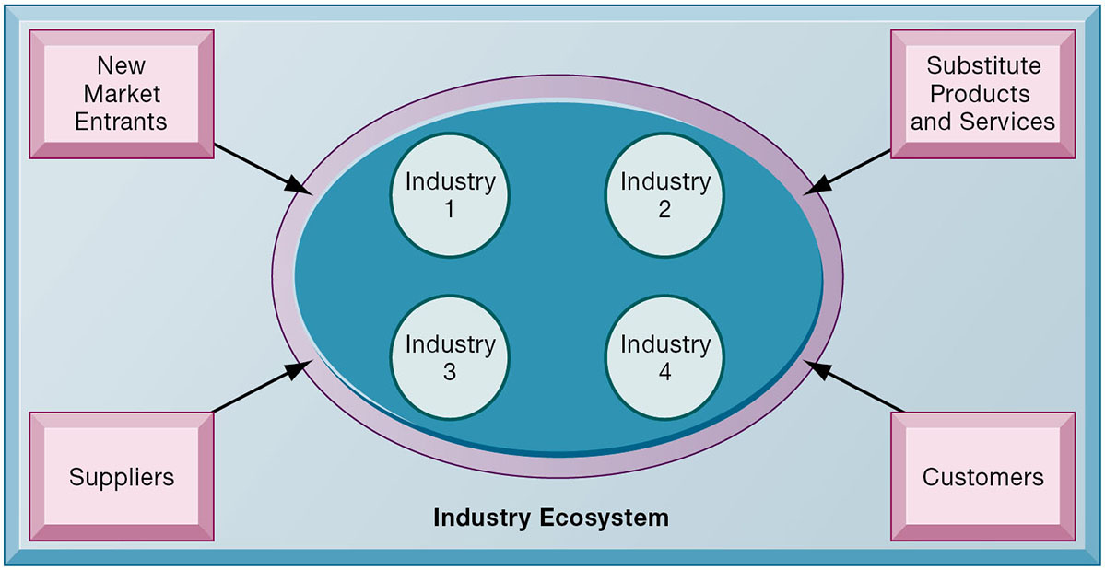
Figure 3.11 An Ecosystem Strategic Model
Notes:
Figure 3.11, Page 109.
The digital firm era requires a more dynamic view of the boundaries among industries, firms, customers, and suppliers, with competition occurring among industry sets in a business ecosystem. In the ecosystem model, multiple industries work together to deliver value to the customer. IT plays an important role in enabling a dense network of interactions among the participating firms.
Emphasize how important IT is in bringing disparate industries together to deliver value to the customer. What are the challenges of coordinating the flow of information across, for example, four different industries, as shown in the figure?

Slide 52
Challenges Posed by Strategic Information Systems
Sustaining competitive advantage
Competitors can retaliate and copy strategic systems
Systems may become tools for survival
Aligning I T with business objectives
Performing strategic systems analysis
Structure of industry
Firm value chains
Managing strategic transitions
Adopting strategic systems requires changes in business goals, relationships with customers and suppliers, and business processes
Notes:
Emphasize the importance and difficulty of aligning information technology with the business. What does this phrase mean? It seems pretty simple. Why do so many companies fail at this critical task? Can students think of any other important questions that management should ask about their company before designing their IT systems? What is a solution for the fact that many competitive advantages can be copied? This fact highlights the importance of continuous innovation in order to stay ahead.

Slide 53
How Will MIS Help My Career?
The Company: Superior Data Quality
Position Description: Entry-level business development representative
Job Requirements
Interview Questions
Author Tips

Slide 54

Copyright
This work is protected by United States copyright laws and is provided solely for the use of instructors in teaching their courses and assessing student learning. Dissemination or sale of any part of this work (including on the World Wide Web) will destroy the integrity of the work and is not permitted. The work and materials from it should never be made available to students except by instructors using the accompanying text in their classes. All recipients of this work are expected to abide by these restrictions and to honor the intended pedagogical purposes and the needs of other instructors who rely on these materials.

